Slide 2
INTRODUCTION
Although the first image that most people have of oil and natural gas development is a drilling rig, the actual process includes many additional steps involving dozens of scientist, engineers and technicians over as long as a decade. The steps can be summarized into:
Finding the right geology.
Leasing.
Geologic evaluation.
Complying with regulatory requirements.
Drilling.
Completing the well, which may include hydraulic fracturing.
Getting the product to market.

Slide 3
FINDING THE RIGHT GEOLOGY
The first requirement for the formation of oil and natural gas is source rocks – that is, having rocks that contain organic carbon and are buried deep enough so temperature and pressure generate oil and natural gas.
Once generated, the buoyant oil and gas often migrate up faults and through rock pores until it is
because they were essentially the only types of deposits commercially developed over the first 100 years of oil production.
The Energy Information Administration defines conventional natural
gas as that produced by a well drilled into a geologic formation in which the reservoir and fluid characteristics permit the gas to readily flow to the wellbore.
Unconventional oil and natural gas deposits, including gas and
trapped below impermeable rocks, and therefore cannot migrate farther.
These accumulations have
been called “conventional,”
oil-rich shales, tight-gas sands and coalbed methane, are geologically diverse – and despite the name
“unconventional,” in reality they
are commonplace, just not
conventional.

Slide 4
FINDING THE RIGHT GEOLOGY
So, what are they?
Unconventional resources have been defined as hydrocarbon reservoirs that have low permeability and porosity – in other words, difficult to produce.
That’s why unconventional resources often require special drilling and recovery methods, including hydraulic fracturing.

Slide 5
LEASING
Leasing Allows Exploration and Production on a Tract of Land
If the geology of a location appears favorable for oil and natural gas accumulations, a company’s next move is to lease or purchase the right to explore on that location, with the goal of developing any oil or natural gas resources found there:
For private property, explorers can directly enter lease or purchase agreements with private landholders to explore on their land.
Local and state lands are administered by the appropriate local entity.
Federal land leases are administered by the Department of Interior’s Bureau of Land Management (BLM, onshore) and Bureau of Ocean Energy Management (BOEM, offshore).
For Native American-owned property, a tribe or the BLM may administer tribal lands.

Slide 6
LEASING
Not all geologically suitable land is available for leasing – including large tracts of federal land, both onshore and offshore. Offshore Florida, California, Oregon and Washington, and parks, wilderness and national monuments are closed to petroleum activities.
Environmentally sensitive areas may also be.
excluded from oil and natural gas operations, or operations may be restricted to certain times of the year to
protect wildlife.

Slide 7
GEOLOGIC ANALYSIS
When preparing a lease bid, geologists will obtain data over their area of interest, including information obtained from wells previously drilled in the area.
One type of data is seismic, where geophysicists use sound waves to create an image of what’s below the earth’s surface.
Geoscientists evaluate these seismic (and other)
oil and natural gas accumulations. Geoscientists are aided by supercomputers, which can merge seismic data with information from previously drilled wells into a detailed, three-dimensional panorama of the subsurface.
Based on this exploration idea, a company then seeks to lease or purchase acreage to test that exploration idea.
data, using their knowledge and experience to identify the specific areas in a
On private land, the explorer negotiates directly with the surface and mineral rights owner to explore on their property.
region that they believe have the highest likelihood of containing

Slide 8
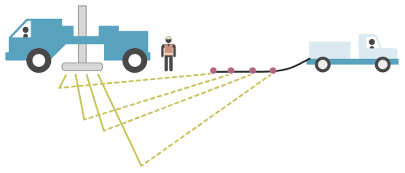
GEOLOGIC ANALYSIS
On federal and state lands acreage is awarded competitively. Federal leases are awarded for a fixed amount of time, from five to 10 years. Once a lease is awarded to an explorer a clock starts: The lease is costing money and the explorer is racing against the clock to conduct the necessary geologic studies and drill a successful well before the lease expires.
With lease in hand, explorers begin the hard work of determining exactly where to drill – and this requires an even more intensive
geological evaluation than before the bid, because drilling a well is expensive.
The explorers typically collect more seismic data, at higher resolution, across the lease to better understand the underlying geology. Often they will also collect other kinds of geophysical, geological and geochemical data.
underlying geology. Often they will also collect
other kinds of geophysical, geological and geochemical data.

Slide 9
GEOLOGIC ANALYSIS
Within their geologic model they select the best drilling target.
They then work with the appropriate government authorities to obtain permission to drill.
Visualization of Seismic Data

Slide 10
COMPLYING WITH REGULATORY REQUIRMENTS
Complying with State and Federal Regulations
All oil and natural gas development is governed by local, state and federal regulations, designed to ensure safe operations and preservation of the environment while balancing the nation’s needs for energy development. The U.S. Bureau of Land Management oversees onshore federal lands and the Bureau of Safety and Environmental Enforcement oversees offshore federal lands,
outside the three to nine-nautical miles of state waters.
Federal regulations on air emissions and underground injection wells are enforced by states or EPA. Activities on private land are regulated by state and local government.

Slide 11
COMPLYING WITH REGULATORY REQUIRMENTS
Regulations vary from state to state but generally cover:
Site development and preparation, including pre-drilling water well testing and setback restrictions from residential and other buildings, and water sources.
Flowback/wastewater storage and disposal, including fluid storage options, flowback/wastewater transportation, and rules for underground injection wells.
Well drilling and production, including casing and cementing regulations, venting and flaring restrictions, and fracking fluid disclosure.
Well plugging and abandonment.

Slide 12
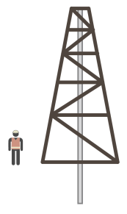
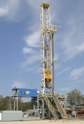
DRILLING
Successful exploration takes skill, hard work and a bit of luck – no one knows for sure if a well is being drilled in the right spot until it is actually drilled.
Drilling is the true test of the geologists’ model, and it isn’t a decision to be made lightly. Drilling costs for a single well can range from less than $1 million for shallow onshore wells to over $100 million in the deep water offshore.
Today horizontal drilling has become a significant part of the U.S. exploration strategies.
Onshore Drilling
Offshore Drilling

Slide 13
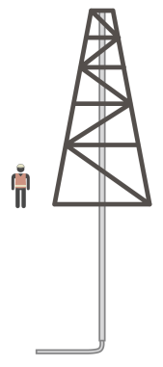
HORIZONTAL DRILLING
Horizontal drilling is the process of drilling a vertical well from the surface to approximately the depth of a producing formation. The wellbore is then deviated from vertical to horizontal, and can be horizontally extended long distances.
The record horizontal distance is over eight miles.
Most oil and gas reservoirs are more extensive in their horizontal dimensions than in their vertical (thickness) dimension. Drilling a well that intersects a reservoir parallel to its most extensive
Greater exposure yields greater fluid flow into the wellbore. This is especially important in reservoirs such as tight sands or shales that have poor flow rates and would not produce economic volumes of oil or gas
from vertical wells.
Horizontal drilling of several wells into different parts of a reservoir from one drilling location or pad also reduces the environmental footprint of drilling operations.
dimension exposes much more of the reservoir rock to the wellbore.
such as tight sands or shales that have poor flow rates and would not produce economic volumes of oil or gas from vertical wells.

Slide 14
OIL PRODUCING FORMATIONS
During the drilling, geologists evaluate data coming from the drill rig to see whether it conforms to their expectations based on the geological model. Eventually, the drill bit reaches the rock layer where geoscientists think the oil or gas is trapped.
If there is no oil and gas when the drill reaches the trap they were targeting, they’ve drilled a dry hole. If they find oil and gas it’s called a discovery.
Technological advancements have greatly enhanced the chance of drilling a successful onshore well.
Thirty years ago over half of all onshore exploratory wells were dry or non-productive. In 2009 onshore dry holes represented only about 12 percent of all wells. However, in the offshore – where production costs are extremely high – larger discoveries are required and dry holes are still over 50 percent of wells.
Even though oil or natural gas has been found, additional testing is required to determine whether the well is a commercial discovery.

Slide 15
WELL COMPLETION
Additional expenditures, often costing more than the cost to drill the well, are required to prepare the well for production. This is called completing a well.
Completion involves lining the well with steel tubing or casing, cementing the casing to the earth, perforating the casing and cement to allow oil and/or natural gas to flow from the earth into the wellbore; and installing pumps to bring the fluids to the surface.
In unconventional oil and natural gas deposits, oil or natural gas does not easily flow into the wellbore without
artificially creating additional flow pathways or fractures in the petroleum-bearing deposit. This process is hydraulic fracturing.
Hydraulic fracturing also may be used to improve the production rates of conventional deposits.

Slide 16
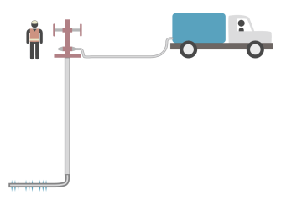
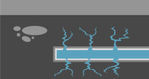
HYDROLIC FRACTURING
Hydraulic fracturing is the process of injecting – under high pressures – water, sand and small quantities of chemicals (for example, chemicals that kill bacteria, preventing their damaging growth in the subsurface).
The high pressures splinter the reservoir rock, opening fluid flow paths or fractures.
The water delivers the sand that holds the fractures open.
The water is then pumped back to the surface where it can be reused, disposed of in licensed injection wells or treated in industrial or municipal water treatment facilities.

Slide 17
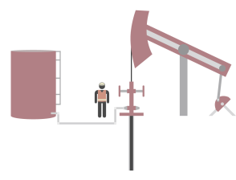
PRODUCTION
After hydraulic fracturing, the well is connected to pipelines that move the production to oil refineries or natural gas processing plants. In some areas, oil production is moved to refineries by truck or rail.

